Slide 1

EDA ANALYSIS ON EBOOKS

Slide 2
About me
Name: Tripura Rajesh Satonkar
Educational Background : Bachelors of computer application(BCA).
College Name : Dayanand College of Commerce, Latur.
Year : Final Year
LinkedIn Profile : https://www.linkedin.com/in/tripura-satonkar-3849b1352
Github Profile : https://github.com/TripuraSatonkar

Slide 3
WEBSCRAPING DETAILS :
WEBSITE LINK : https://www.gutenberg.org/
Web scraping is an automated technique used to extract the data from websites.
Instead of manually copying information, web scraping uses a python libraries like requests or beautiful soup, etc.
It is specially useful when data is not directly available through official websites.
In short web scraping is the automated way to collect structured data from websites for analysis and business use.

Slide 4

BUSINESS PROBLEM :
How can virtual library or online publishing market understand that which books are more popular, or
which books are getting downloaded frequently, or how the authors are publishing in which languages ,etc.
By scrapping / analyzing data we aim to ans :
Which books / authors are most popular among readers ?
What reading formats are mostly preferred by the users (EPUB or kindle or Text)
How do file size and availability influence downloads ?
OBJECTIVE OF THE PROJECT :
My main objective of this project is to :
Collect and clean book related data from project Gutenberg using web scraping techniques.
Analyze download trends to identify the most popular books, authors, and genres.
Explore the relationship between file size, availability, and user engagement.
Mostly to provide insights that can help digital publishers, e-libraries, and online platforms to improve
digitization and user experience.

Slide 5
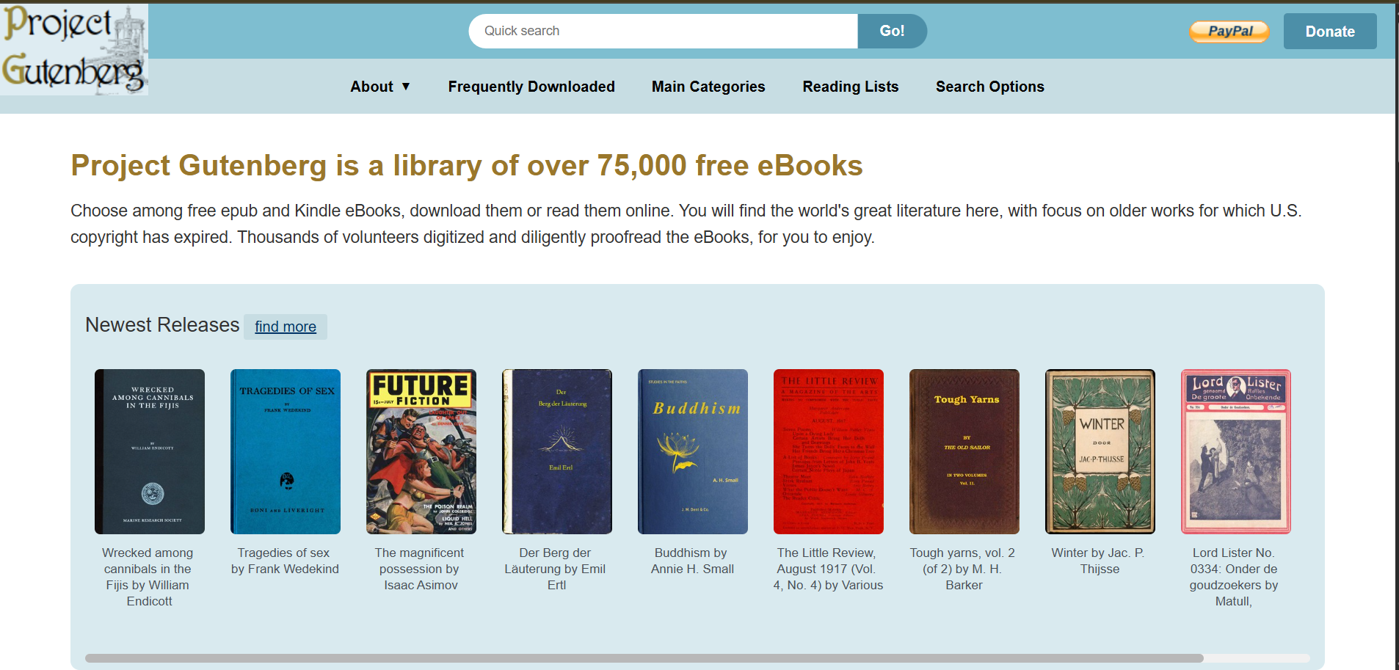
Interface of the website :

Slide 6
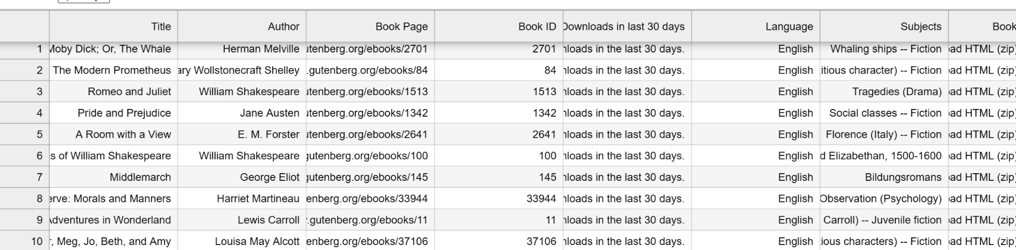
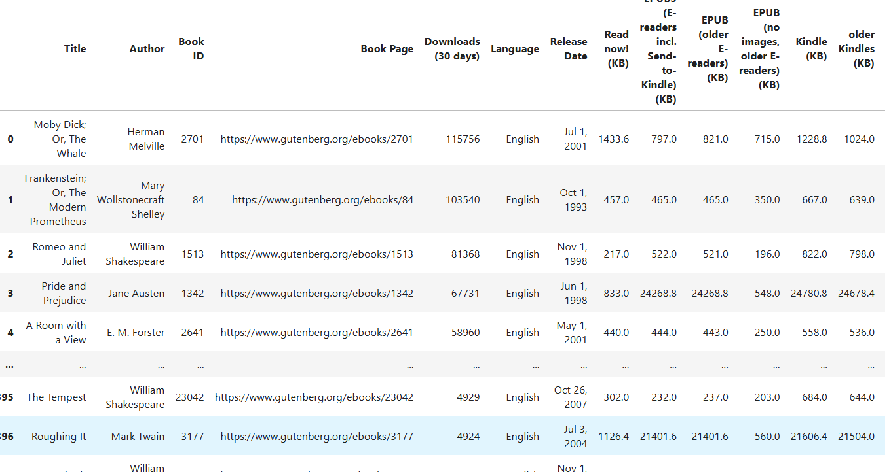
DATA CLEANING
OLD DATAFRAME :
This was my old data frame which was uncleaned so I decided to perform some operations on it.
In this, I performed unique values, finding that are there any NULL values and also arranged the columns in a proper format.
NEW DATAFRAME :
This is my cleaned dataset. Where I have performed some Operations to make the data more cleaned.

Slide 7
DATA VISUALIZATION :
Data visualization is the process of representing data into a visual format like charts or graphs.
In the visualization process we can transform data into visuals(such as bar charts, pie charts, scatter plots,heatmaps,etc.)
It makes complex data easier to interpret at a glance.
Used in decision-making for business research and everyday problem solving.
In short, data visualization is nothing but turning data into pictures for better understanding.

Slide 8
VISUALIZATION TECHNIQUES
UNIVARIATE ANALYSIS :
Univariate analysis is nothing but analyzing one variable at a time, using stats visualizations
to understand it’s distribution, spread, and key patterns.
BIVARIATE ANALYSIS :
Bivariate analysis means analyzing the relationship between two variables at the same time.
One variable is usually independent (predictor) and the other is dependent (outcomes).
3) MULTIVARIATE ANALYSIS :
Multivariate analysis is the process of analyzing three or more variables at the same time to
understand their combined effects, relationships, or patterns.

Slide 9
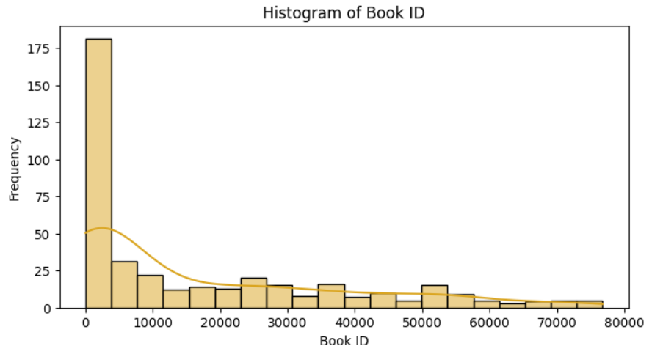
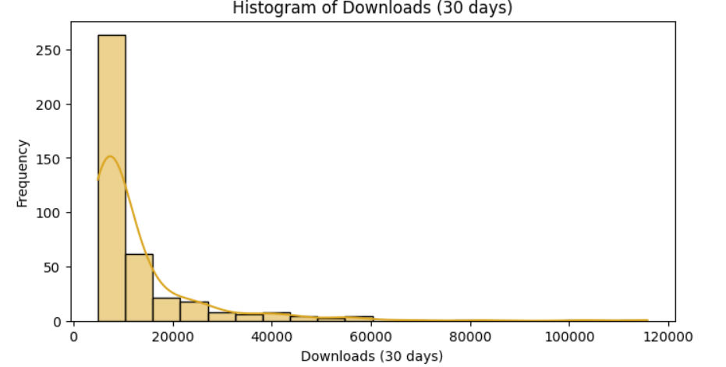
UNIVARIATE ANALYSIS ON NUMERICAL COLUMNS
Histogram for BOOK ID and downloads in last 30 days
OBSERVATION :
This is the histogram for BOOK ID and Downloads in last 30 days ( Both are numeric columns).
Here we can observe :
Shape of histogram is right-skewed.
The variable shows high variability. Most variables are clustered in a small range.
In this, most values of BOOK ID are between 10000 to 70000.

Slide 10
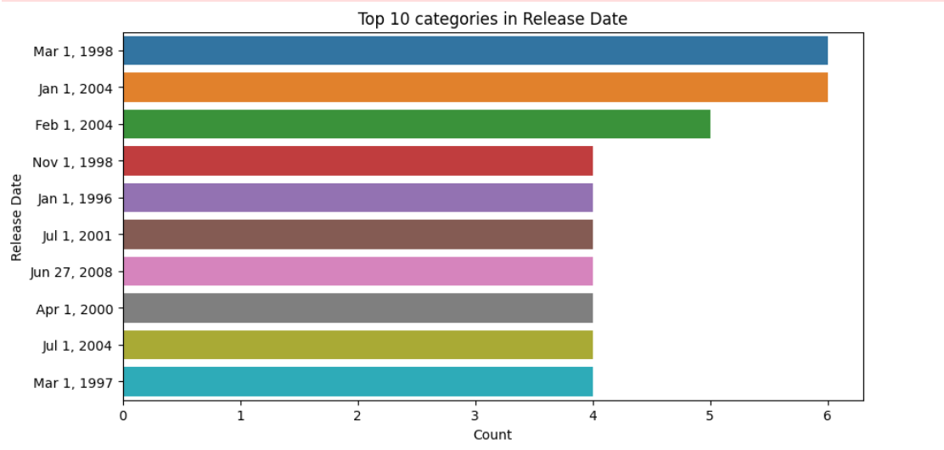
UNIVARIATE ANALYSIS ON CATEGORICAL COLUMN
COUNTPLOT FOR TOP 10 CATEGORY IN RELEASE DATE IES
OBSERVATIONS :
The distribution of release dates is highly uneven. A small number of release years dominate the dataset, while most years contribute only a few books. This indicates a skewed distribution, which we need to account for in further analysis.
Top 10 release years together represent a large proportion of the dataset, suggesting historical clustering of publications.
The chart highlights which years/dates had the highest number of book releases.

Slide 11
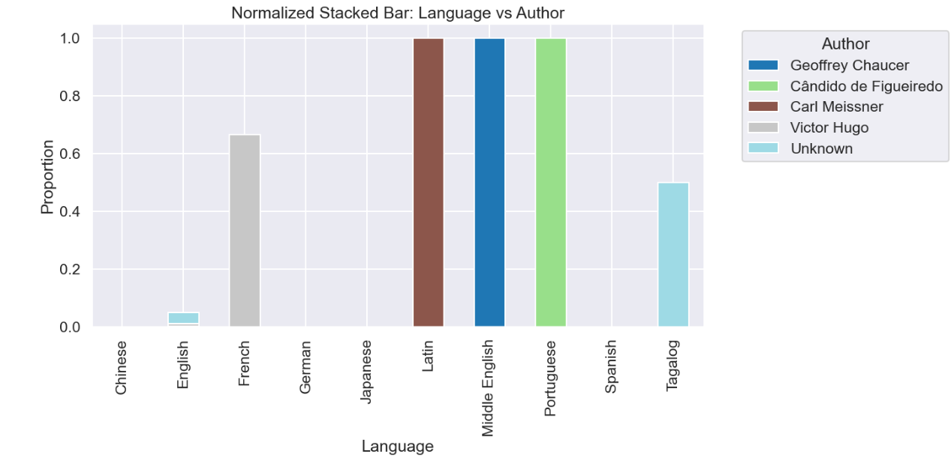
BIVARIATE ANALYSIS ON NUMERIC COLUMNS
NORMALISED STACKED BAR PLOT FOR AUTHOR VS LANGUAGE
OBSERVATIONS :
The stacked bar shows which authors are most prominent in each language.
Each bar sums to 100% for that language, so the focus is on relative dominance of authors rather than dataset size.
This helps identify which authors are more widely represented in Gutenberg’s collection.
Some languages may be dominated by a single author, while others show diverse contributions.

Slide 12
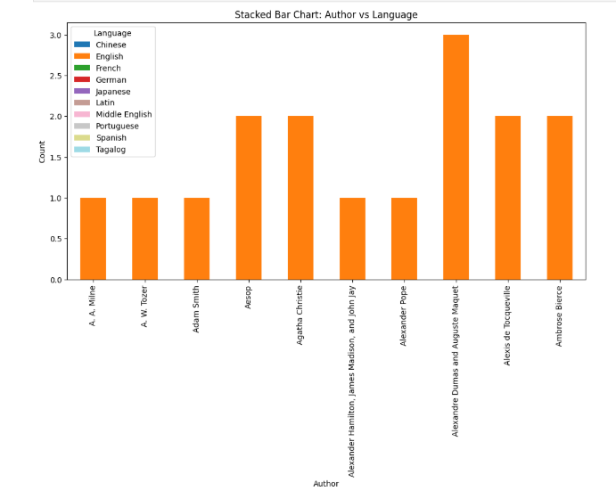
STACKED BAR CHART FOR AUTHOR VS LANGUAGE
STACKED BARCHART : Stacked bar chart is a type of bar chart where each bar is divided into multiple segments.
OBSERVATIONS :
This stacked bar chart says that the colored segments inside the bar represent how those books are divided across different languages.
Author with a single color bar mainly wrote in one language and the author with multi-colored bars contributed books in multiple languages.
The chart helps to compare which authors are more productive and which languages dominate among top 10 authors.

Slide 13
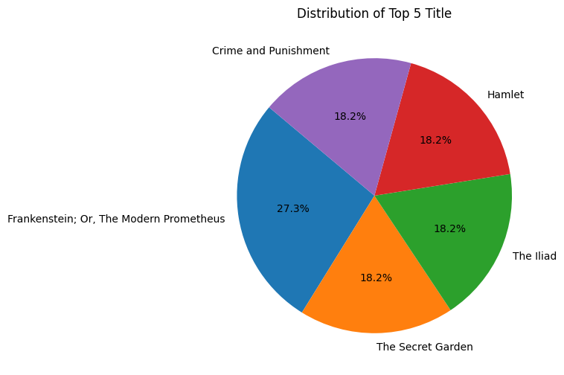
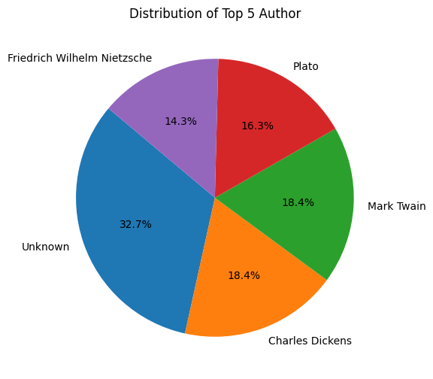
Insights from Top 5 Titles and Authors Distribution
OBSERVATIONS :
Most Popular Book Title: Frankenstein; Or, The Modern Prometheus leads the top 5 titles with 27.3% share, indicating it is the most frequently listed or read among the dataset.
Diverse Literary Preferences: The top titles include classic literature from different genres and eras—novels (Frankenstein, The Secret Garden), tragedies (Hamlet).
Dominance of Unknown Authors: In the top 5 authors, a large proportion (32.7%) is categorized as “Unknown,”
Prominent Classic Authors: Among known authors, Charles Dickens and Mark Twain are tied at 18.4%, followed by Plato (16.3%) and Friedrich Wilhelm Nietzsche (14.3%).

Slide 14
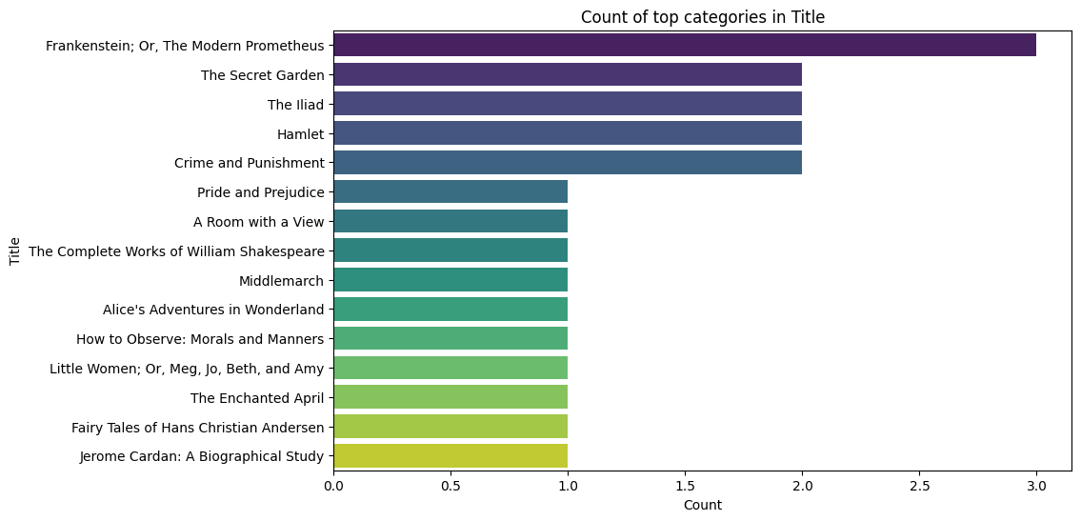
Category Count by Title: Identifying Topically Rich Literary Works
OBSERVATIONS :
Frankenstein; Or, The Modern Prometheus has the highest category count at 3.0, standing out significantly from all other titles.
Four titles ("The Secret Garden," "The Iliad," "Hamlet," "Crime and Punishment") form the second-highest group with a count of 2.0.
The majority of the remaining titles (9 out of 14) share a low count of 1.0, including well-known works like "Pride and Prejudice" and "Middlemarch.

Slide 15
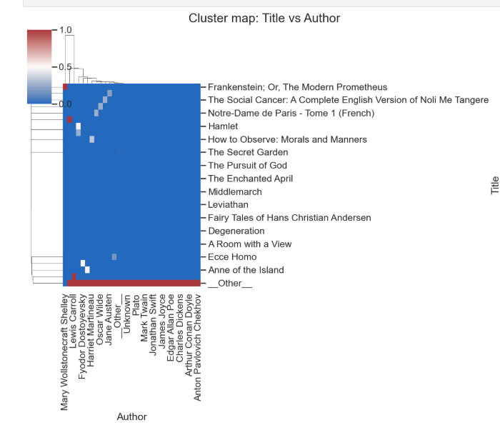
MULTIVARIATE ANALYSIS ON NUMERICAL COLUMN
CLUSTER MAP FOR TITLE VS AUTHOR
OBSERVATIONS :
Categories (authors, subjects, or languages) that often co-occur are clustered together. authors writing in similar languages get grouped on one branch.
Darker/ brighter blocks highlight strong associations. English dominates as a language grouping most authors under one cluster.
Categories with unique patterns (not similar to other) will form their own small cluster.
Category relationships where certain subjects may cluster together because they are written in the same language group. You can see which categories of col_x have similar distributions across col_y.

Slide 16
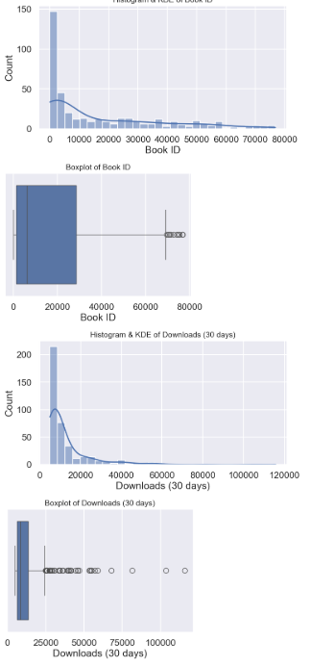
UNIVARIATE ANALYSIS FOR NUMERICAL VS NUMERICAL COLUMNS
HISTOGRAM AND KDE PLOT FOR BOOK ID
OBSERVATIONS :
The histogram show whether each numeric variable is normally distributed or skewed.
The KDE curve helps to identify the shape of the data distributions.
The boxplots reveals the spread of values, median, and presence of outliers.
Variables with wider boxes (IQR) indicate greater variability.

Slide 17
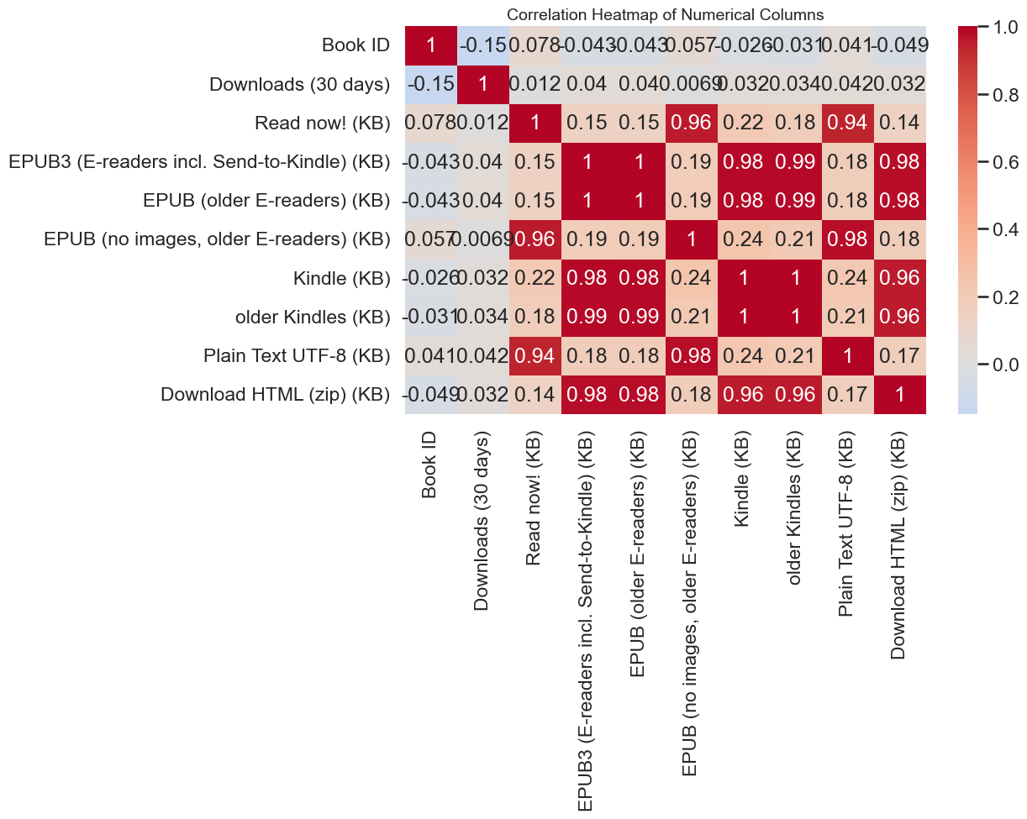
BIVARIATE ANALYSIS ON NUMERICAL COLUMN
Correlation Heatmap of E-book File Sizes and Usage Metrics
OBSERVATIONS
File Sizes are Redundant: All e-book format file size columns (EPUB, Kindle, HTML zip, Plain Text) are extremely highly positively correlated (≈0.96 to 0.99) with each other.
Downloads are Independent: The Downloads (30 days) metric shows a negligible correlation (≈−0.15 to 0.03) with all file sizes and other metrics, suggesting usage is independent of file size.
Weak Usage-Size Link: "Read now!" counts show only a weak to moderate positive correlation (highest at 0.24) with the file size columns, implying a minor link between content volume and immediate readership.

Slide 18
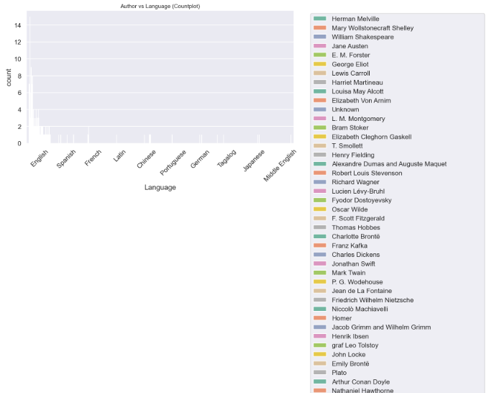
BIVARIATE ANALYSIS FOR CATEGORICAL VS CATEGORICAL COLUMN
OBSERVATIONS :
Each language’s bar is divided by authors, showing who contributes to which language.
The plot highlights both the popularity of languages and the distribution of authors across them.
It mainly illustrates the distribution of books across different languages, further broken down by author contributions.

Slide 19

THANK YOU
BY : TRIPURA RAJESH SATONKAR

